Slide 1
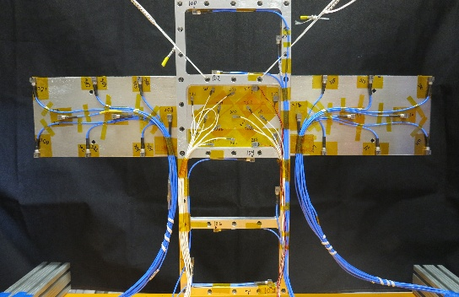
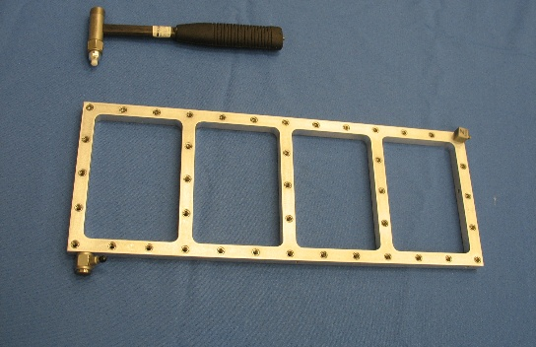
Module 7: The Frame & Wing Structure and Examples

Slide 2
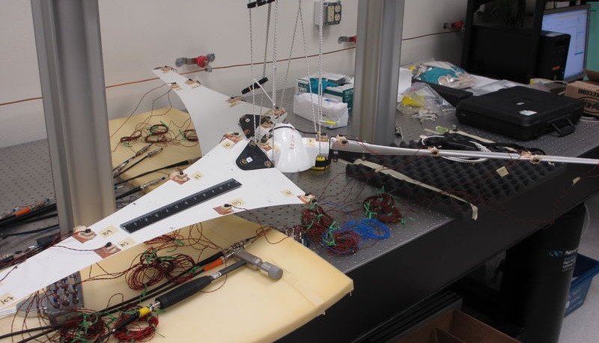
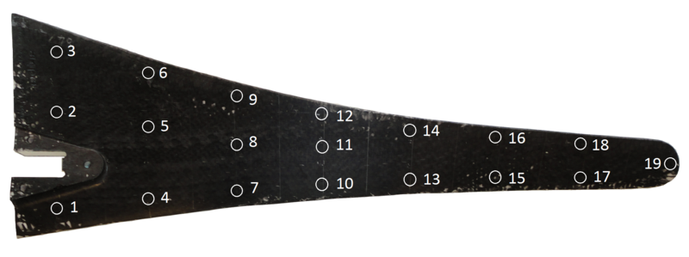
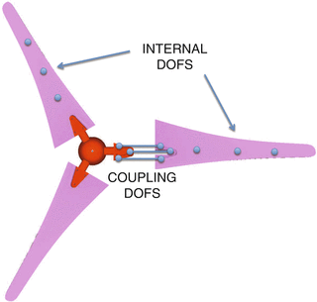
Background
The substructuring community has a rich history which shares its roots with model reduction and structural modification
Each year we see 4-5 sessions on substructuring at IMAC with various topics including:
Component Mode Synthesis
Frequency Based Substructuring
Transfer Path Analysis
Model Reduction
Applications of Substructuring
Real-time Hybrid Substructuring and many more
In 2012 the AmpAir 600 Wind Turbine was selected as a round-robin substructuring example that many universities and research groups have studied
The Dynamic Substructuring focus group continued organizing IMAC sessions and in 2018 it officially became a technical division.

Slide 3

Round-Robin Challenge
The Technical Division on Dynamic Substructuring has formed a team to begin creating a new round-robin challenge for researchers to utilize
To develop a structure that suits everyone’s needs the team assembled a list of desired qualities that the round-robin challenge structure should have:
Interfaces challenging and suited for both FBS and CMS techniques
Simpler system than the Ampair with more similar dynamics between substructures
Potential for future circular transfer paths
Repeatability designed into the interfaces
Nonlinear dynamics due to joints in the structure should be minimized
Something that is easy to manufacture and transport
Structure that is simple to test

Slide 4
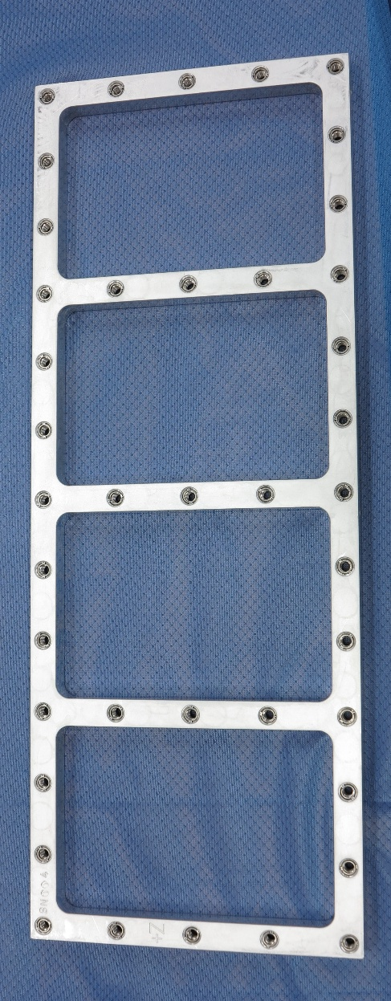
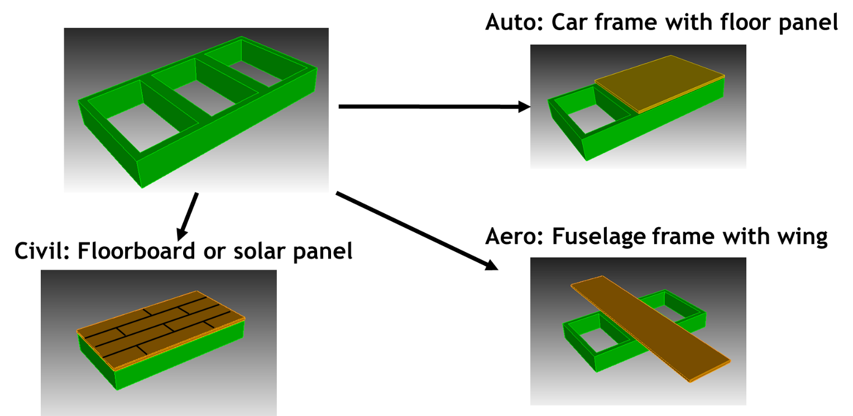
Experimental Substructure (Four-unit frame)
Team developed four unit frame with key features
Manufactured from one piece of metal of stock
Subcomponent and shaker attachment points machined into frame
Adaptable to many types of studies
Possible circular/recursive transfer path
Large enough to minimize error due to mass loading
Shown is a 3-unit frame (final design has 4 units)

Slide 5

What is the “truth” answer?
Truth depends on a lot of factors:
Assembly procedure
Frequency range of interest
Linearity of joints
And other factors…
The goal of this round-robin isn’t to see which method is the closest to truth
Instead… Round-Robin goals include:
Fostering collaboration between universities and industrial researchers
Help researchers focus on how to best approach a substructuring problem when truth is unknown
Discuss different approaches taken and why some are more suited for specific connection interfaces
See range of blind predictions to understand the range of answer found using substructuring practices
It depends… but we can learn a lot by comparing and collaborating on methods

Slide 6
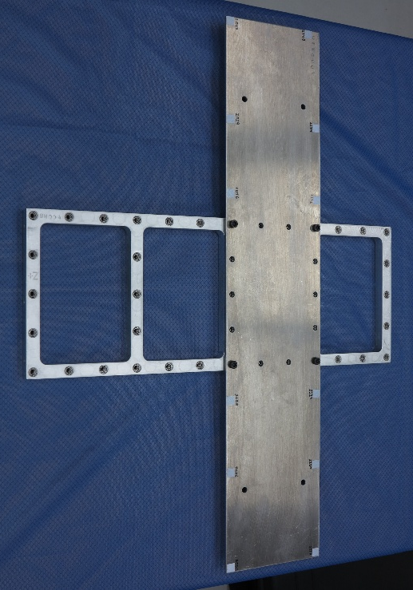
Trial Run
SNL performed a trial run on the “original design” system
Initially presented results from a numerical study performed while designing the system.
Then performed experimental analytical hybrid substructuring using the transmission simulator method to connect the 4-unit frame with an analytical model of the rectangular wing.
-
+
=
Experiment
FEM

Slide 7
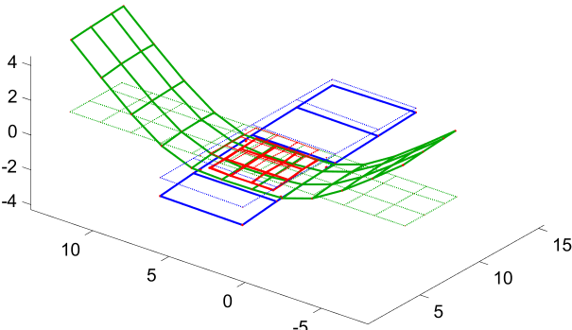
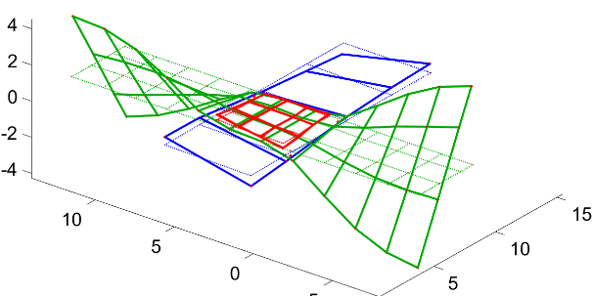
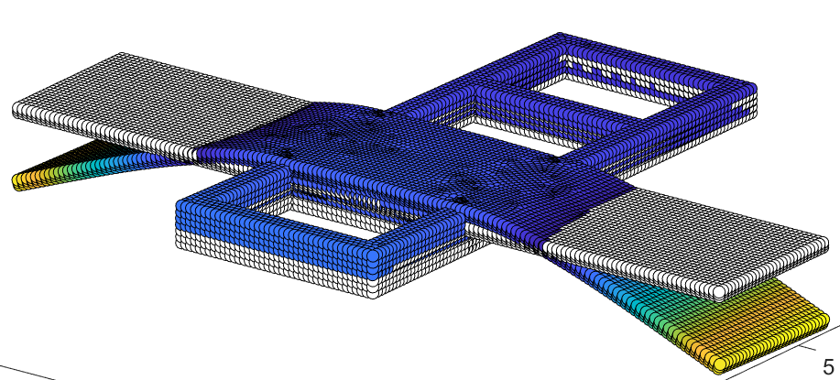
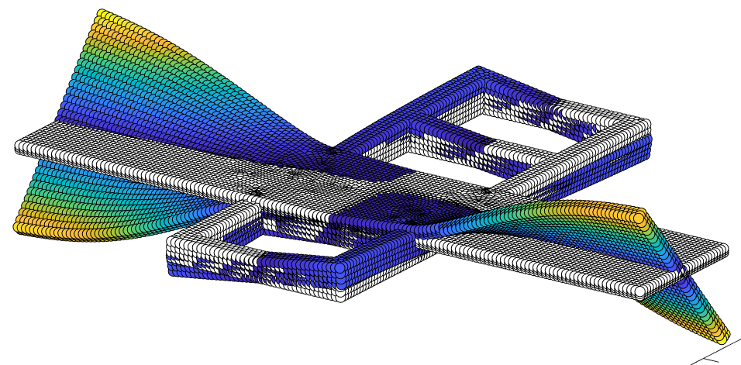
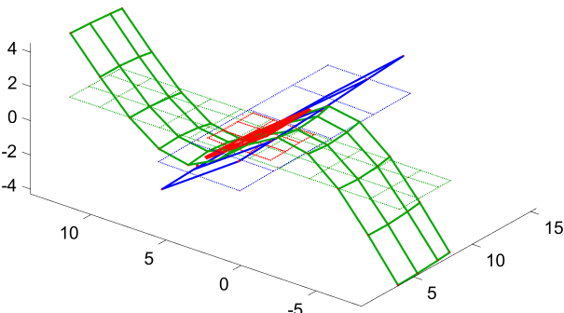
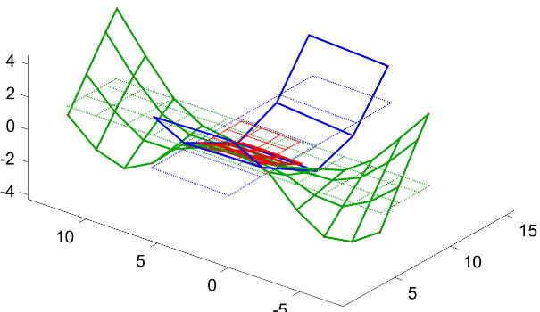
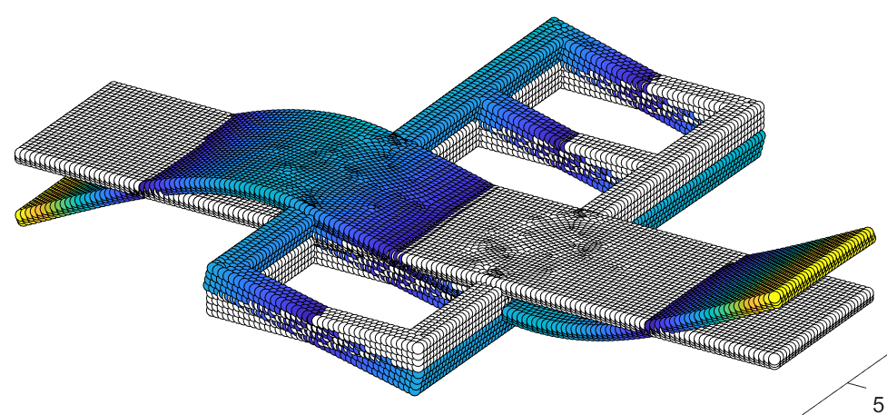
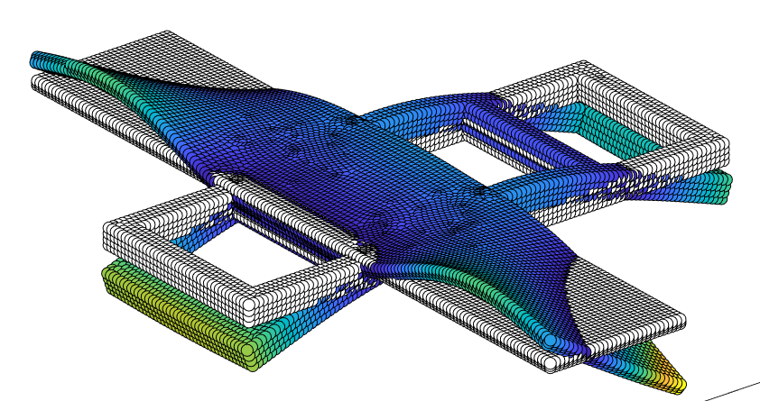
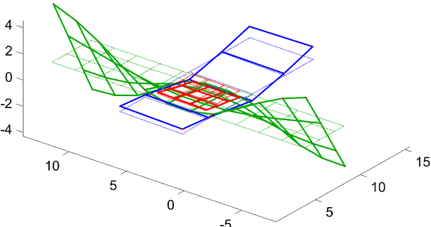
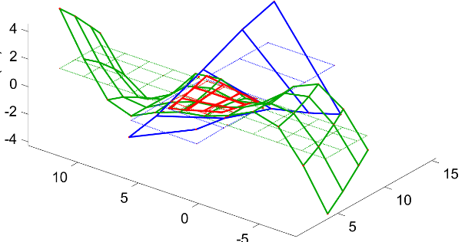
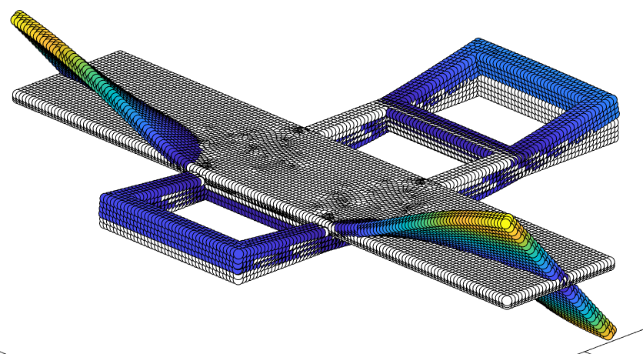
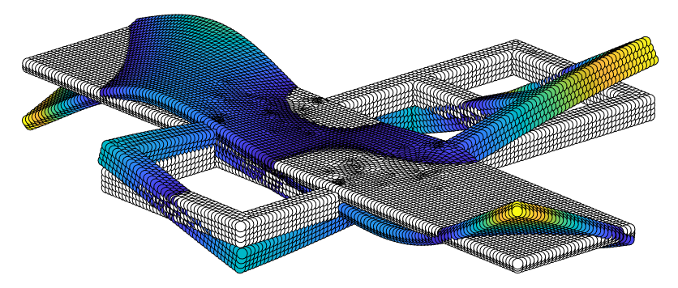
Trial Results
Results were compared to an updated truth FEM model
58.8 Hz
218 Hz
64.0 Hz
233 Hz
98.3 Hz
272 Hz
115 Hz
293 Hz
212 Hz
293 Hz
238 Hz
332 Hz

Slide 8
Trial Results #2
Mode matching provided good predictions of mode shape and frequency with some spurious modes
Hybrid Prediction
FEM Result

Slide 9
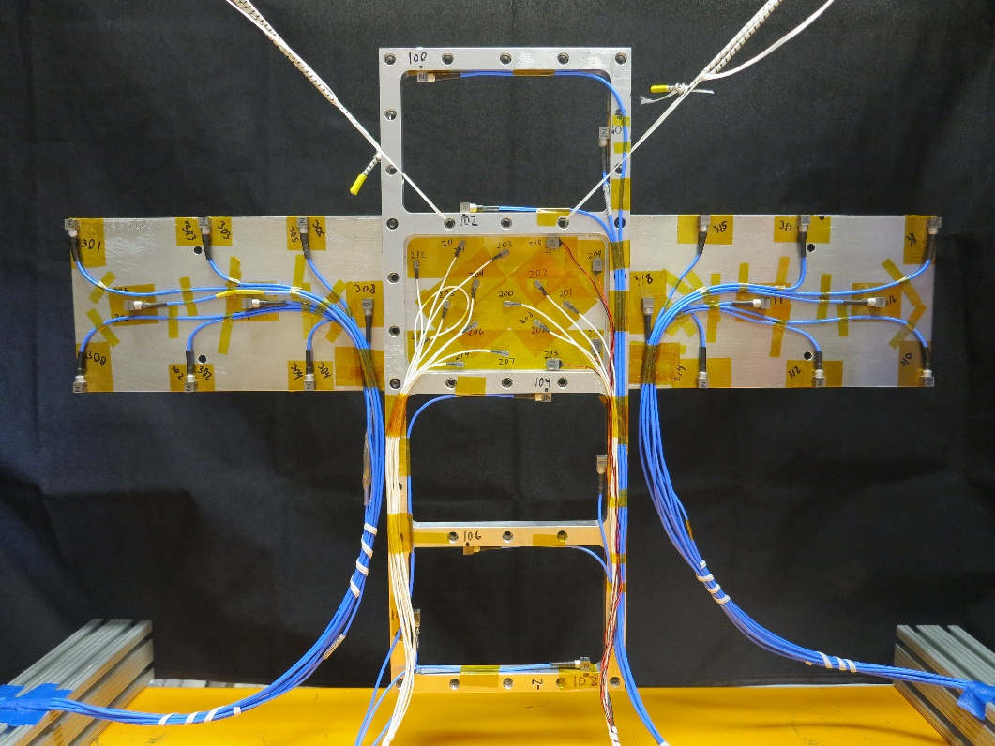
Let’s put this mornings lectures to use!
Through the rest of Module 7 we will attempt linear substructuring with real Frame & Wing test data!
Notes:
So, the motivation behind my project, was that last year, a lot of work was done practicing substructuring techniques on the test bed at low, linear response levels. But, since there is a bolted joint interface between the wing and frame, we can expect that some degree of nonlinear response will manifest at higher forcing levels. So what we did for this year was to screen the assembly for nonlinear behavior, and then form a nonlinear pseudo-modal model and try to project that nonlinearity through the linear substructuring prediction.

Slide 10

Substructuring Diagram
Transmission
Simulator!
Plate
The goal of this example is to take a frame, plate, and thin-wing assembly, and use experimental substructuring to remove the thin-wing and replace it with the thick-wing.
Frame
Thin Wing, 1/8”
Thick Wing, 1/4”
-
=
+
Notes:
Here is a diagram to give you an idea of what we’re trying to do with substructuring. [NEXT] The goal is to start with an assembly of the frame, a transmission simulator plate, and the thin rectangular wing, [NEXT] decouple the dynamics of the plate and thin wing, [NEXT] and then replace it by coupling in the plate and thick wing. [NEXT] And then this will give us a prediction of the frame, plate, and thick wing assembly. So in addition to getting a linear prediction, we want to form a nonlinear pseudo-modal model of the original assembly, and project that through to get a prediction of the nonlinear response of the thick wing assembly.

Slide 11
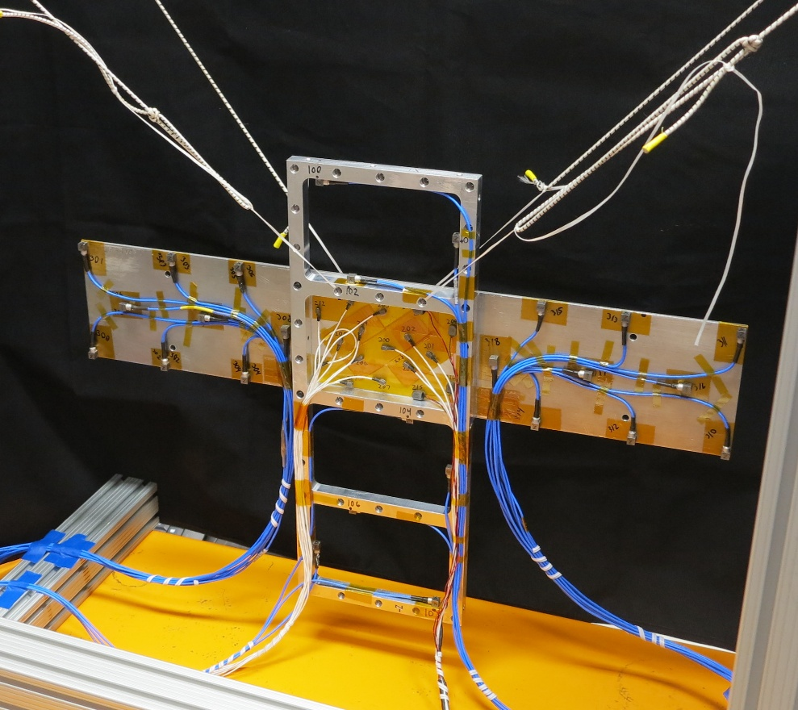
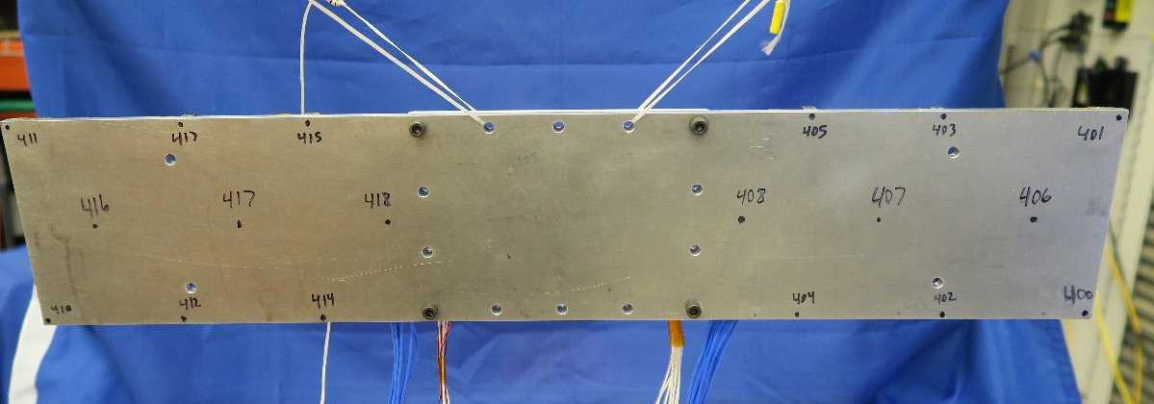
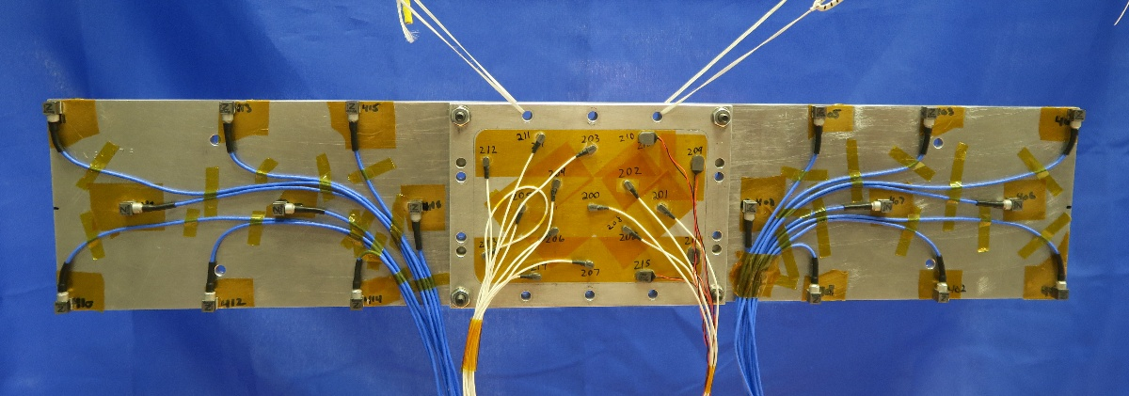
Experimental Setup
Testing was performed on all three substructures and the truth assembly using hammer impacts and accelerometers – the structure was densely instrumented with accelerometers to characterize modes to at least 1600 Hz.
Lets use these experimental mode sets to complete dynamic substructuring.
Notes:
To get the experimental data I needed for each assembly, I did very standard linear modal testing, where the assemblies were suspended with bungee cords and then impacted with a modal hammer. I instrumented with a lot of accelerometers to try and get a good spatial resolution of the mode shapes out to at least 1600 Hz. I initially had washers between the components, but this made the system response too linear. Which is bad in this case since we need to see some sort of nonlinear behavior in order to model and project it. So for all data shown here, there are no washers in the interfaces. And each is held together by 4 steel bolts in the corners of the plate.

Slide 12
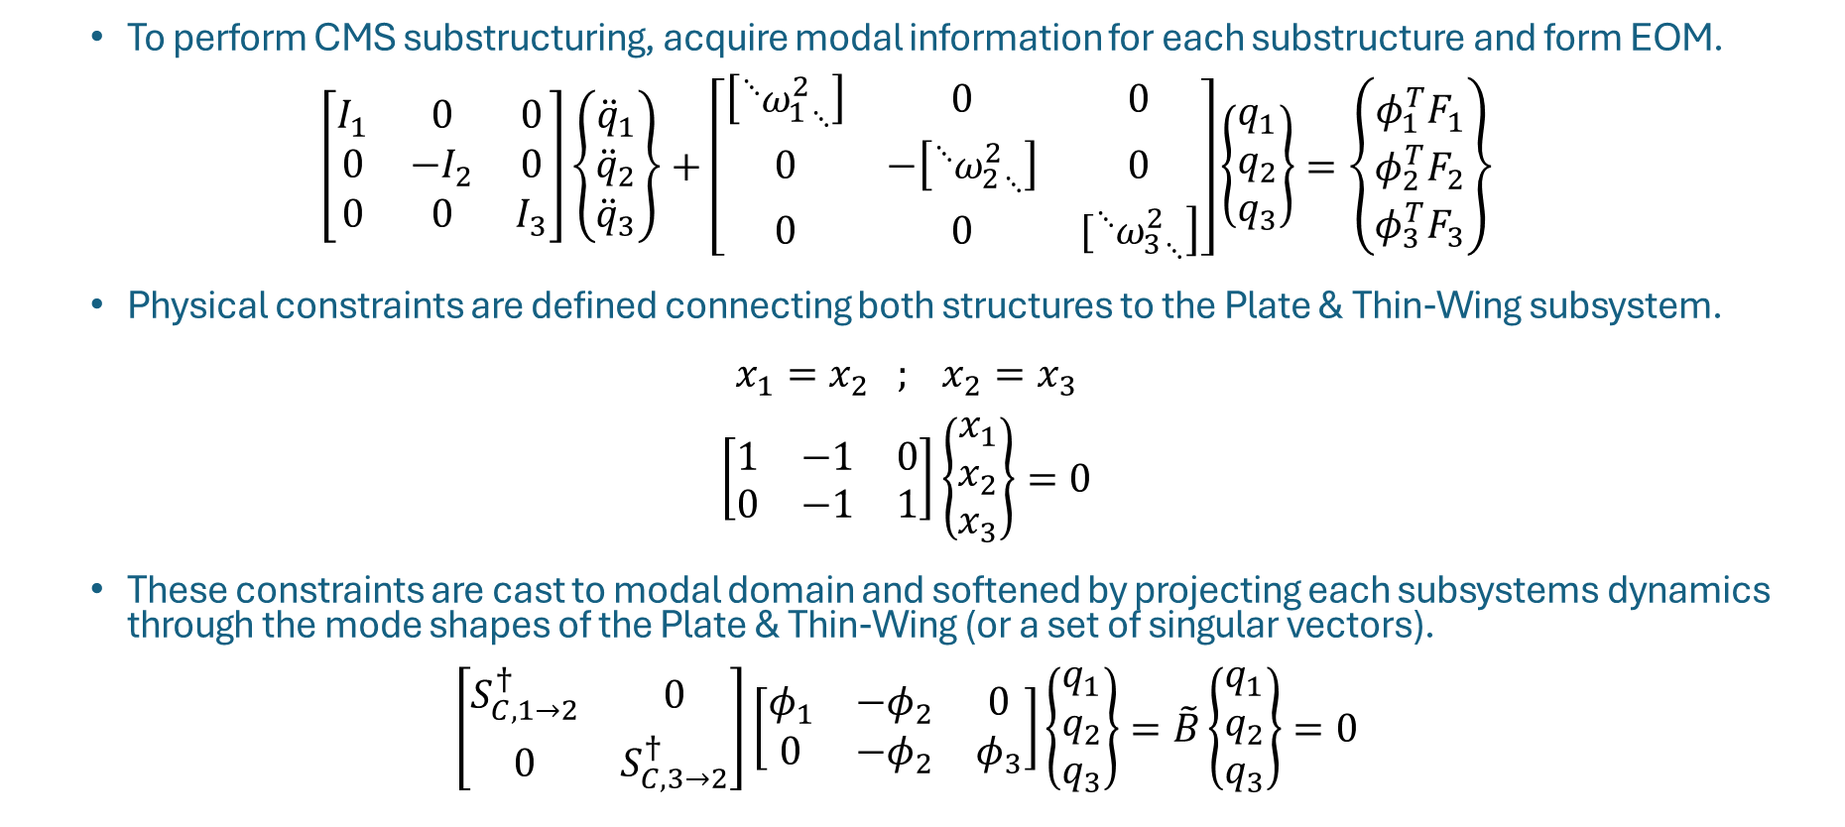
CSM Substructuring Theory – TSM
1: Frame, Plate & Thin-Wing
2: Plate & Thin-Wing
3: Plate & Thick-Wing
To perform CMS substructuring, acquire modal information for each substructure and form EOM.
$$\left[\begin{matrix}I_{1} & 0 & 0 \\ 0 & −I_{2} & 0 \\ 0 & 0 & I_{3}\end{matrix}\right]\left\{\begin{matrix}{\ddot{q}}_{1} \\ {\ddot{q}}_{2} \\ {\ddot{q}}_{3}\end{matrix}\right\}+\left[\begin{matrix}\left[{{}_{ }^{⋱}{ω_{1}^{2}}}_{⋱}\right] & 0 & 0 \\ 0 & −\left[{{}_{ }^{⋱}{ω_{2}^{2}}}_{⋱}\right] & 0 \\ 0 & 0 & \left.[{{}_{ }^{⋱}{ω_{3}^{2}}}_{⋱}\right]\end{matrix}\right]\left\{\begin{matrix}q_{1} \\ q_{2} \\ q_{3}\end{matrix}\right\}=\left\{\begin{matrix}φ_{1}^{T}F_{1} \\ φ_{2}^{T}F_{2} \\ φ_{3}^{T}F_{3}\end{matrix}\right\}$$
Physical constraints are defined connecting both structures to the Plate & Thin-Wing subsystem.
$$x_{1}=x_{2} ; x_{2}=x_{3}$$
$$\left[\begin{matrix}1 & −1 & 0 \\ 0 & −1 & 1\end{matrix}\right]\left\{\begin{matrix}x_{1} \\ x_{2} \\ x_{3}\end{matrix}\right\}=0$$
These constraints are cast to modal domain and softened by projecting each subsystems dynamics through the mode shapes of the Plate & Thin-Wing (or a set of singular vectors).
$$\left[\begin{matrix}S_{C,1→2}^{†} & 0 \\ 0 & S_{C,3→2}^{†}\end{matrix}\right]\left[\begin{matrix}φ_{1} & {−φ}_{2} & 0 \\ 0 & {−φ}_{2} & φ_{3}\end{matrix}\right]\left\{\begin{matrix}q_{1} \\ q_{2} \\ q_{3}\end{matrix}\right\}=\tilde{B}\left\{\begin{matrix}q_{1} \\ q_{2} \\ q_{3}\end{matrix}\right\}=0$$
Notes:
To substructure together each of those experimental subsystems, I used component mode synthesis. So we start with an equation of motion with each of the subsystems initially uncoupled. [NEXT] To tie them together, we define a set of constraints between the overlapping degrees of freedom in each. [NEXT] Usually these sorts of hard constraints lead to poor results, so what we can do is cast them to modal coordinates, and then soften the constraints by projecting them through a representative of the motion at the interface. Where that can be directly mode shapes or an SVD representation of them.

Slide 13
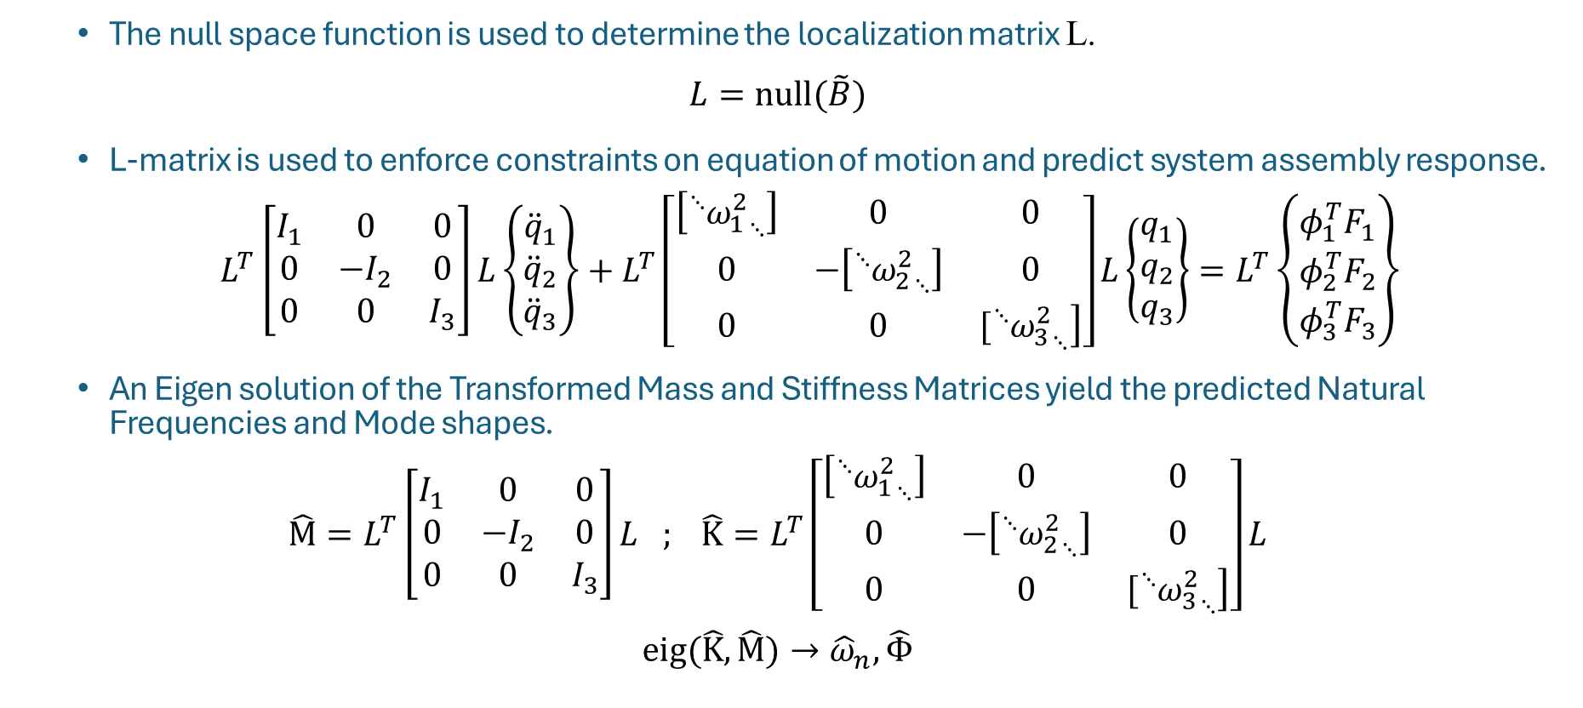
CSM Substructuring Theory – TSM
1: Frame, Plate & Thin-Wing
2: Plate & Thin-Wing
3: Plate & Thick-Wing
The null space function is used to determine the localization matrix L.
$$L=null(\tilde{B})$$
L-matrix is used to enforce constraints on equation of motion and predict system assembly response.
$L^{T}\left[\begin{matrix}I_{1} & 0 & 0 \\ 0 & −I_{2} & 0 \\ 0 & 0 & I_{3}\end{matrix}\right]L\left\{\begin{matrix}{\ddot{q}}_{1} \\ {\ddot{q}}_{2} \\ {\ddot{q}}_{3}\end{matrix}\right\}+L^{T}\left[\begin{matrix}\left[{{}_{ }^{⋱}{ω_{1}^{2}}}_{⋱}\right] & 0 & 0 \\ 0 & −\left[{{}_{ }^{⋱}{ω_{2}^{2}}}_{⋱}\right] & 0 \\ 0 & 0 & \left.[{{}_{ }^{⋱}{ω_{3}^{2}}}_{⋱}\right]\end{matrix}\right]L\left\{\begin{matrix}q_{1} \\ q_{2} \\ q_{3}\end{matrix}\right\}=L^{T}\left\{\begin{matrix}φ_{1}^{T}F_{1} \\ φ_{2}^{T}F_{2} \\ φ_{3}^{T}F_{3}\end{matrix}\right\}$
An Eigen solution of the Transformed Mass and Stiffness Matrices yield the predicted Natural Frequencies and Mode shapes.
$$\hat{M}=L^{T}\left[\begin{matrix}I_{1} & 0 & 0 \\ 0 & −I_{2} & 0 \\ 0 & 0 & I_{3}\end{matrix}\right]L ; \hat{K}=L^{T}\left[\begin{matrix}\left[{{}_{ }^{⋱}{ω_{1}^{2}}}_{⋱}\right] & 0 & 0 \\ 0 & −\left[{{}_{ }^{⋱}{ω_{2}^{2}}}_{⋱}\right] & 0 \\ 0 & 0 & \left.[{{}_{ }^{⋱}{ω_{3}^{2}}}_{⋱}\right]\end{matrix}\right]L$$
$$eig(\hat{K},\hat{M})→{\hat{ω}}_{n},\hat{Φ}$$
Notes:
So since were trying to constrain motion together and the equations equate to zero, we can solve for the coupling transformation matrix as the null space of that B matrix of constraints. So then we can use that to pre and post multiply the uncouple M and K, and then get the predicted mode shapes and frequencies from an eigensolution of the coupled M and K.

Slide 14
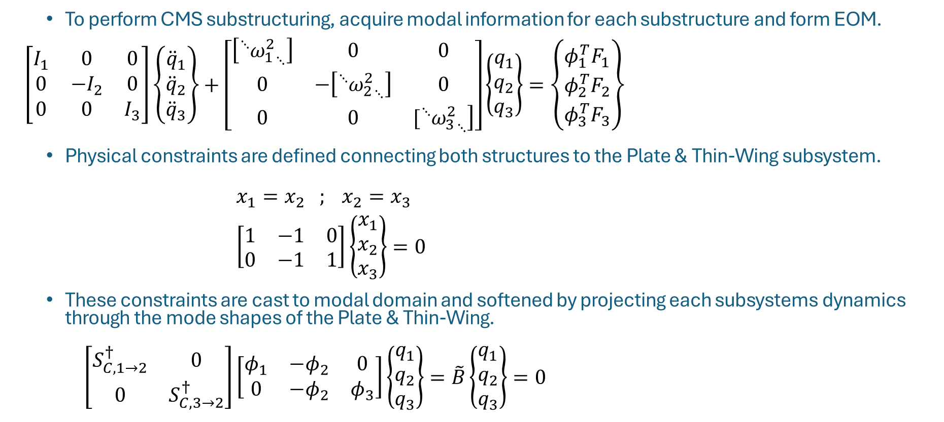
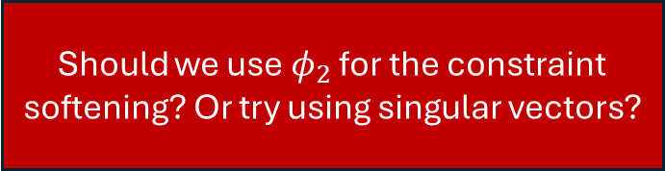
Choices for the Practitioner to Make
1: Frame, Plate & Thin-Wing
2: Plate & Thin-Wing
3: Plate & Thick-Wing
To perform CMS substructuring, acquire modal information for each substructure and form EOM.
$$\left[\begin{matrix}I_{1} & 0 & 0 \\ 0 & −I_{2} & 0 \\ 0 & 0 & I_{3}\end{matrix}\right]\left\{\begin{matrix}{\ddot{q}}_{1} \\ {\ddot{q}}_{2} \\ {\ddot{q}}_{3}\end{matrix}\right\}+\left[\begin{matrix}\left[{{}_{ }^{⋱}{ω_{1}^{2}}}_{⋱}\right] & 0 & 0 \\ 0 & −\left[{{}_{ }^{⋱}{ω_{2}^{2}}}_{⋱}\right] & 0 \\ 0 & 0 & \left.[{{}_{ }^{⋱}{ω_{3}^{2}}}_{⋱}\right]\end{matrix}\right]\left\{\begin{matrix}q_{1} \\ q_{2} \\ q_{3}\end{matrix}\right\}=\left\{\begin{matrix}φ_{1}^{T}F_{1} \\ φ_{2}^{T}F_{2} \\ φ_{3}^{T}F_{3}\end{matrix}\right\}$$
Physical constraints are defined connecting both structures to the Plate & Thin-Wing subsystem.
$x_{1}=x_{2} ; x_{2}=x_{3}$
$\left[\begin{matrix}1 & −1 & 0 \\ 0 & −1 & 1\end{matrix}\right]\left\{\begin{matrix}x_{1} \\ x_{2} \\ x_{3}\end{matrix}\right\}=0$
These constraints are cast to modal domain and softened by projecting each subsystems dynamics through the mode shapes of the Plate & Thin-Wing.
$\left[\begin{matrix}S_{C,1→2}^{†} & 0 \\ 0 & S_{C,3→2}^{†}\end{matrix}\right]\left[\begin{matrix}φ_{1} & {−φ}_{2} & 0 \\ 0 & {−φ}_{2} & φ_{3}\end{matrix}\right]\left\{\begin{matrix}q_{1} \\ q_{2} \\ q_{3}\end{matrix}\right\}=\tilde{B}\left\{\begin{matrix}q_{1} \\ q_{2} \\ q_{3}\end{matrix}\right\}=0$
How many modes should we include for each structure?
Which DOFs should we constrain in our subtraction and addition steps?
Should we use $φ_{2}$ for the constraint softening? Or try using singular vectors?
Notes:
To substructure together each of those experimental subsystems, I used component mode synthesis. So we start with an equation of motion with each of the subsystems initially uncoupled. [NEXT] To tie them together, we define a set of constraints between the overlapping degrees of freedom in each. [NEXT] Usually these sorts of hard constraints lead to poor results, so what we can do is cast them to modal coordinates, and then soften the constraints by projecting them through a representative of the motion at the interface. Where that can be directly mode shapes or an SVD representation of them.

Slide 15
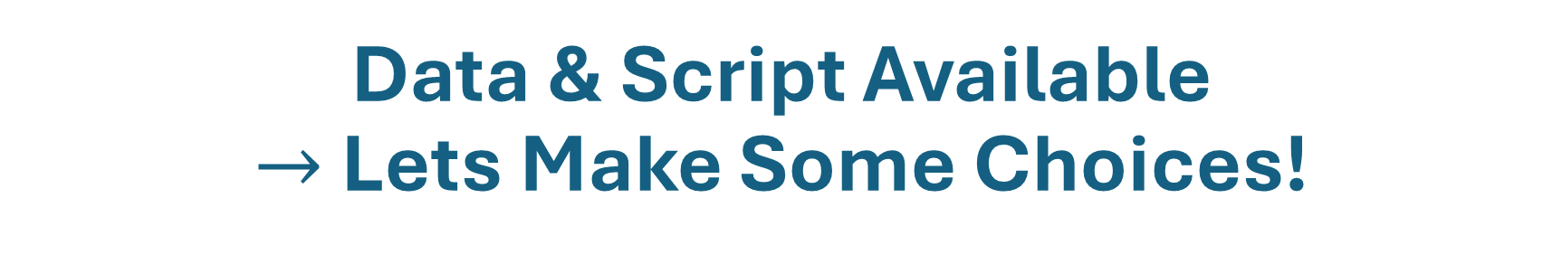
Data & Script Available $→$ Lets Make Some Choices!

Slide 16
Frame & Wing Example Exercise
SS1: Frame, Plate & Thin-Wing
SS2: Plate & Thin-Wing
SS3: Plate & Thick-Wing
SS4: Frame, Plate & Thick-Wing
Test Data: FrameWing_Data.mat
MATLAB Script: Mod7_FrameWing_Example.m
Which modes should be used to define each subsystem?
Should constraints for adding the thick wing be just in the middle or also on the wings?
Is the constraint softening done with modes or singular vectors?
Try different inputs and check the MAC and FRF result plots that come up
SS1
SS2
SS4
-
=
SS3
+

Slide 17
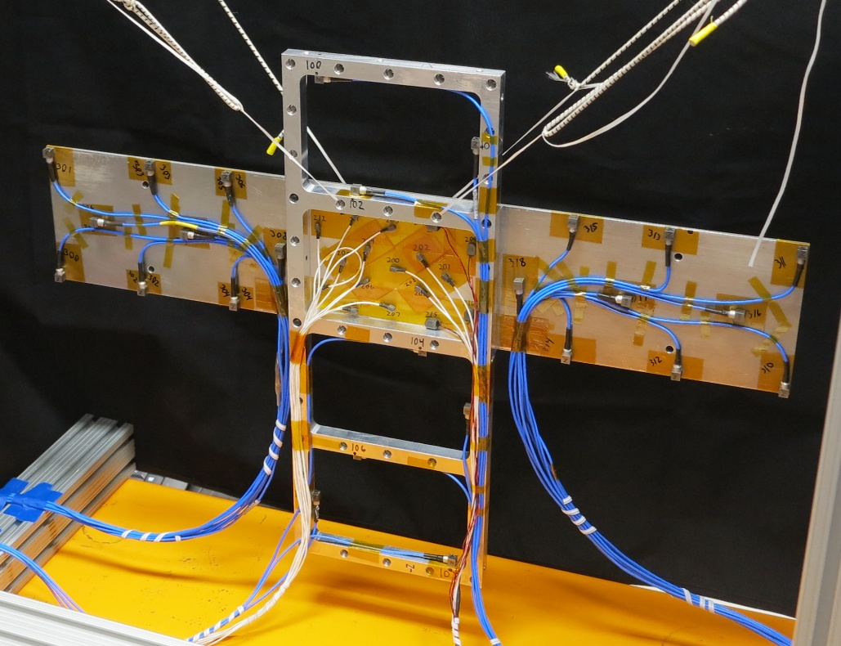

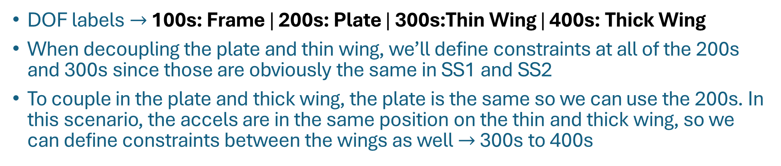
Info On the Constraint Options
DOF labels $→$ 100s: Frame | 200s: Plate | 300s:Thin Wing | 400s: Thick Wing
When decoupling the plate and thin wing, we’ll define constraints at all of the 200s and 300s since those are obviously the same in SS1 and SS2
To couple in the plate and thick wing, the plate is the same so we can use the 200s. In this scenario, the accels are in the same position on the thin and thick wing, so we can define constraints between the wings as well $→$ 300s to 400s
Plate: 200s
Frame: 100s
Thin: 300s
Thick: 400s
Plate: 200s
Thin: 300s
Thick: 400s

Slide 18
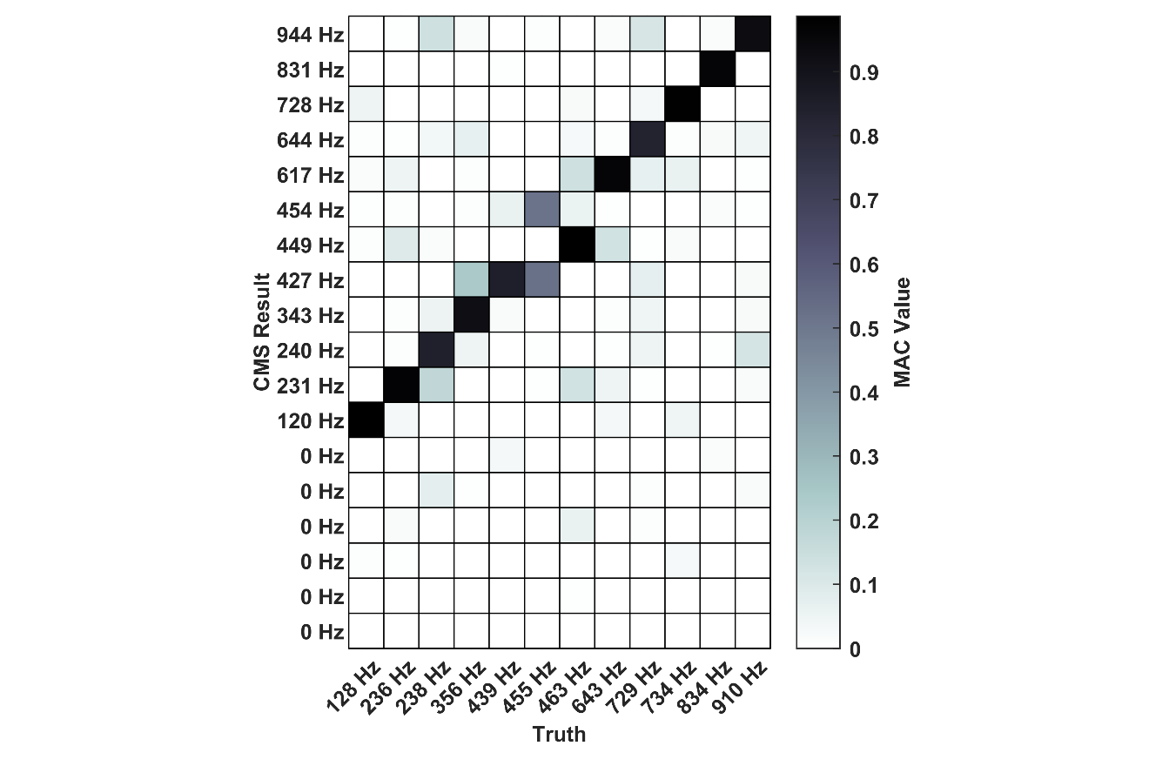
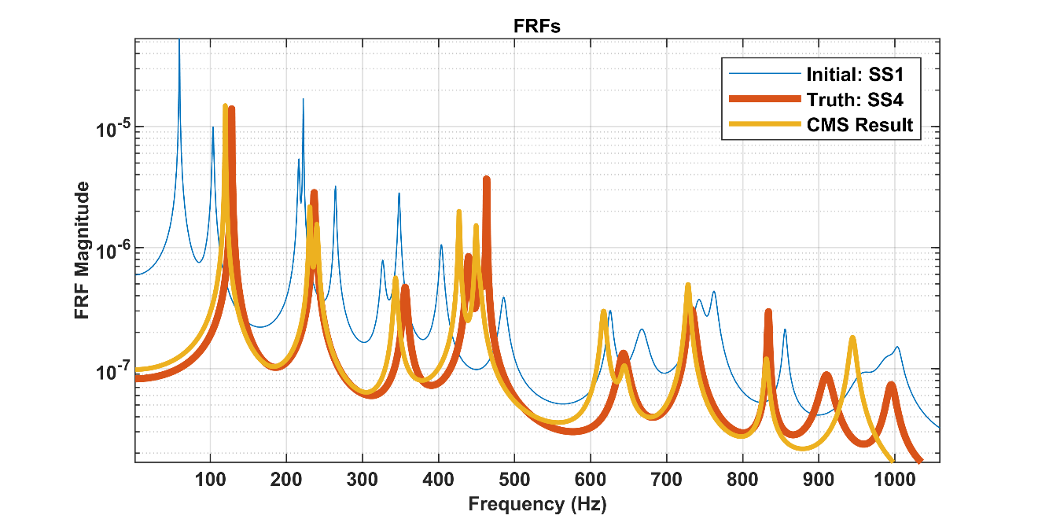
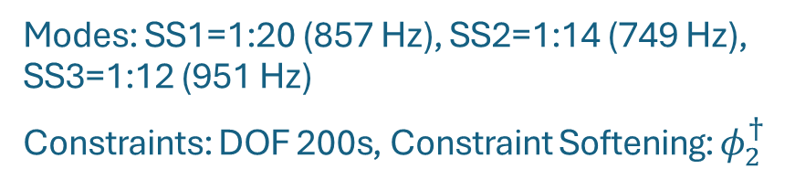
Linear CMS Results #1
Modes: SS1=1:20 (857 Hz), SS2=1:14 (749 Hz), SS3=1:12 (951 Hz)
Constraints: DOF 200s, Constraint Softening: $φ_{2}^{†}$
Mode | Truth wn | CMS wn | Error % | Truth zt | CMS zt | Error % | MAC
1 | 127.8 | 119.5 | -6.49 | 0.23 | 0.28 | 23.5 | 0.99
2 | 236.2 | 230.7 | -2.34 | 0.35 | 0.38 | 8.3 | 0.97
3 | 237.6 | 240.0 | 0.99 | 0.78 | 0.62 | -20.1 | 0.84
4 | 356.1 | 343.4 | -3.56 | 0.70 | 0.59 | -14.8 | 0.92
5 | 439.4 | 427.0 | -2.81 | 0.51 | 0.21 | -58.1 | 0.85
6 | 454.6 | 427.0 | -6.06 | 0.59 | 0.21 | -63.9 | 0.52
7 | 463.1 | 449.2 | -3.00 | 0.06 | 0.24 | 311.3 | 0.98
8 | 643.0 | 617.0 | -4.04 | 0.99 | 0.49 | -50.0 | 0.96
9 | 728.9 | 644.4 | -11.59 | 0.30 | 0.78 | 158.7 | 0.83
10 | 733.5 | 728.1 | -0.75 | 0.58 | 0.34 | -42.5 | 0.98
11 | 833.7 | 831.1 | -0.31 | 0.13 | 0.30 | 142.7 | 0.96
12 | 910.2 | 944.4 | 3.76 | 0.90 | 0.46 | -48.4 | 0.93
Notes:
Here are the linear substructuring predictions, where I guess you could say it’s a cheated or informed answer, where I had the truth data and tuned the content in each subsystem to best match that. I think its justified here because the focus of this work is on the viability of the nonlinear projection, so having the best linear prediction helps in narrowing in on that result which ill show later. So, we have good results out to about 100 Hz, with mostly under 3 or 4 percent error. The damping is admittedly all over the place, but it was also the same when trying to measure it experimentally, where the nonlinearity in the joint kept causing the linear value to shift around and it didn’t really settle. And the MAC values are pretty good too.

Slide 19
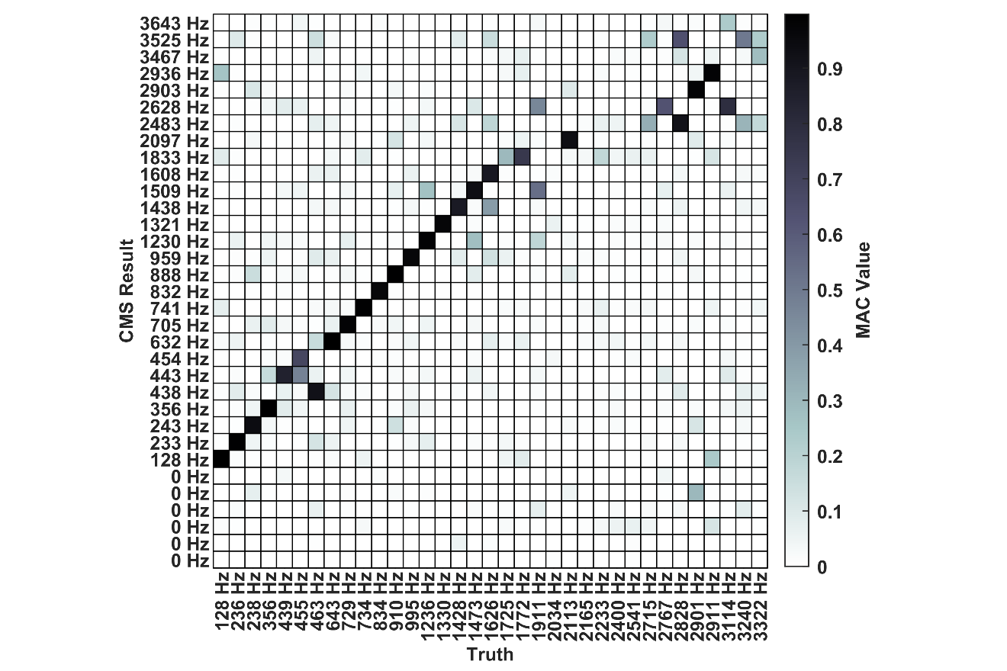
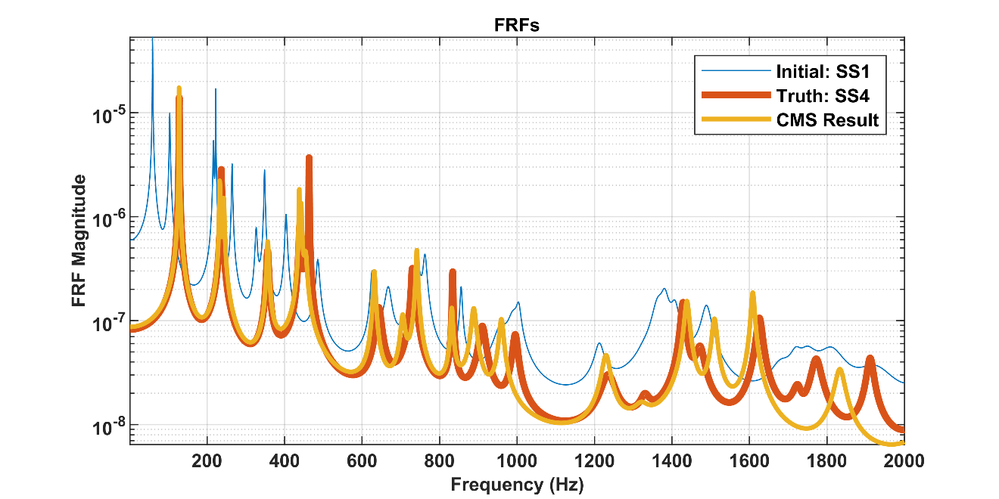
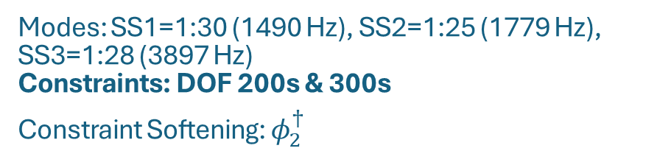
Linear CMS Results #2
Modes: SS1=1:30 (1490 Hz), SS2=1:25 (1779 Hz), SS3=1:28 (3897 Hz) Constraints: DOF 200s & 300s
Constraint Softening: $φ_{2}^{†}$
Mode | Truth wn | CMS wn | Error % | Truth zt | CMS zt | Error % | MAC
1 | 127.8 | 127.7 | -0.12 | 0.23 | 0.11 | -52.7 | 1.00
2 | 236.2 | 232.6 | -1.55 | 0.35 | 0.38 | 10.7 | 0.99
3 | 237.6 | 242.8 | 2.16 | 0.78 | 0.64 | -17.8 | 0.94
4 | 356.1 | 356.4 | 0.09 | 0.70 | 0.60 | -14.2 | 0.99
5 | 439.4 | 442.6 | 0.73 | 0.51 | 0.34 | -33.2 | 0.85
6 | 454.6 | 454.3 | -0.06 | 0.59 | 0.73 | 23.5 | 0.68
7 | 463.1 | 437.7 | -5.48 | 0.06 | 0.19 | 231.8 | 0.92
8 | 643.0 | 631.5 | -1.79 | 0.99 | 0.41 | -58.4 | 0.99
9 | 728.9 | 704.8 | -3.31 | 0.30 | 0.70 | 132.3 | 0.98
10 | 733.5 | 741.2 | 1.04 | 0.58 | 0.29 | -50.7 | 0.99
11 | 833.7 | 831.6 | -0.25 | 0.13 | 0.31 | 146.0 | 0.96
12 | 910.2 | 888.2 | -2.42 | 0.90 | 0.63 | -29.3 | 0.99
13 | 995.2 | 959.5 | -3.60 | 0.61 | 0.53 | -12.5 | 0.96
14 | 1235.5 | 1229.7 | -0.47 | 1.36 | 0.79 | -42.0 | 0.98
15 | 1329.9 | 1320.5 | -0.71 | 0.78 | 1.30 | 66.2 | 0.97
16 | 1428.5 | 1438.4 | 0.70 | 0.37 | 0.39 | 4.9 | 0.88
17 | 1472.5 | 1509.5 | 2.51 | 0.69 | 0.39 | -43.3 | 0.93
18 | 1625.5 | 1608.5 | -1.05 | 0.44 | 0.26 | -41.3 | 0.89
20 | 1772.2 | 1833.2 | 3.45 | 0.70 | 0.64 | -7.7 | 0.75
23 | 2112.5 | 2096.8 | -0.74 | 0.73 | 0.50 | -31.9 | 0.93
29 | 2767.5 | 2628.0 | -5.04 | 0.74 | 0.25 | -66.1 | 0.63
31 | 2900.8 | 2902.5 | 0.06 | 0.23 | 0.23 | -1.2 | 0.98
32 | 2910.8 | 2935.7 | 0.85 | 0.22 | 0.22 | -2.0 | 0.98

Slide 20
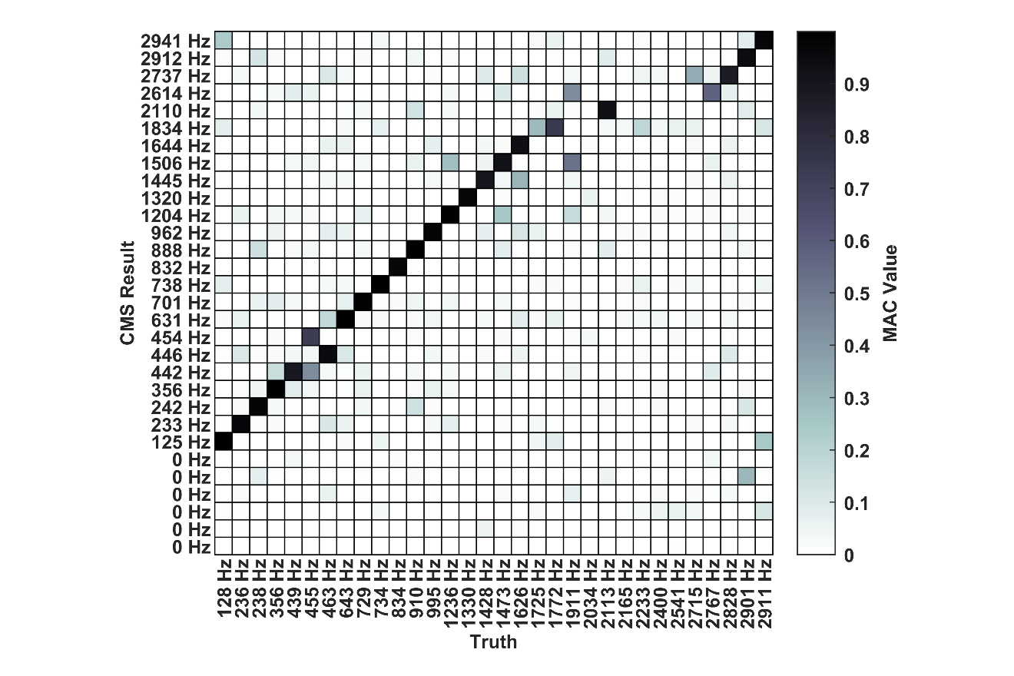
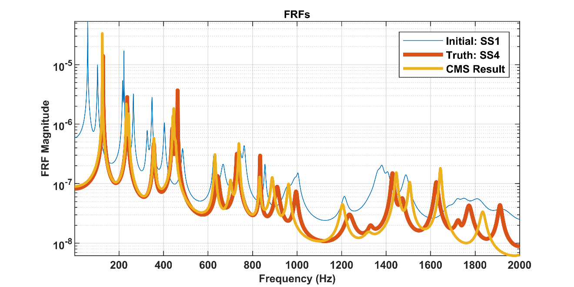
Linear CMS Results #3
Modes: SS1=1:30 (1489 Hz), SS2=1:23 (1560 Hz), SS3=1:26 (3649 Hz) Constraints: DOF 200s & 300s
Constraint Softening: SVD (10%,10%)
Mode | Truth wn | CMS wn | Error % | Truth zt | CMS zt | Error % | MAC
1 | 127.8 | 125.0 | -2.22 | 0.23 | 0.11 | -52.0 | 1.00
2 | 236.2 | 232.6 | -1.55 | 0.35 | 0.39 | 12.8 | 0.96
3 | 237.6 | 242.4 | 2.01 | 0.78 | 0.63 | -18.6 | 0.97
4 | 356.1 | 356.4 | 0.09 | 0.70 | 0.60 | -14.2 | 0.99
5 | 439.4 | 441.8 | 0.55 | 0.51 | 0.36 | -30.0 | 0.89
6 | 454.6 | 453.9 | -0.16 | 0.59 | 0.72 | 22.1 | 0.73
7 | 463.1 | 446.0 | -3.70 | 0.06 | 0.19 | 228.2 | 0.95
8 | 643.0 | 630.7 | -1.91 | 0.99 | 0.41 | -59.0 | 0.99
9 | 728.9 | 700.6 | -3.89 | 0.30 | 0.70 | 132.0 | 0.98
10 | 733.5 | 738.5 | 0.68 | 0.58 | 0.29 | -50.6 | 0.99
11 | 833.7 | 831.8 | -0.22 | 0.13 | 0.31 | 144.5 | 0.96
12 | 910.2 | 888.2 | -2.42 | 0.90 | 0.64 | -28.7 | 0.99
13 | 995.2 | 961.6 | -3.39 | 0.61 | 0.54 | -11.3 | 0.97
14 | 1235.5 | 1204.0 | -2.56 | 1.36 | 0.82 | -40.1 | 0.99
15 | 1329.9 | 1320.3 | -0.73 | 0.78 | 1.30 | 66.2 | 0.97
16 | 1428.5 | 1445.5 | 1.19 | 0.37 | 0.37 | 0.9 | 0.89
17 | 1472.5 | 1505.6 | 2.25 | 0.69 | 0.38 | -44.9 | 0.92
18 | 1625.5 | 1643.9 | 1.13 | 0.44 | 0.26 | -41.7 | 0.93
20 | 1772.2 | 1833.8 | 3.48 | 0.70 | 0.64 | -8.5 | 0.74
23 | 2112.5 | 2110.1 | -0.11 | 0.73 | 0.50 | -32.1 | 0.92
30 | 2828.2 | 2737.2 | -3.22 | 0.34 | 0.22 | -35.9 | 0.87
31 | 2900.8 | 2911.8 | 0.38 | 0.23 | 0.23 | 0.1 | 0.95
32 | 2910.8 | 2940.9 | 1.03 | 0.22 | 0.22 | -2.3 | 0.97

Slide 21
Another Example from the Wiki - Thin Wing to Swept Wing -

Slide 22

Substructuring Diagram
The goal of this example is to take a frame, plate, and thin-wing assembly, and use experimental substructuring to remove the thin-wing and plate, then replace it with the swept wing
We wanted to perform this prediction blind without measuring truth and develop tools and habits for successful blind substructuring.
EXP
-
EXP
=
FEM
+

Slide 23
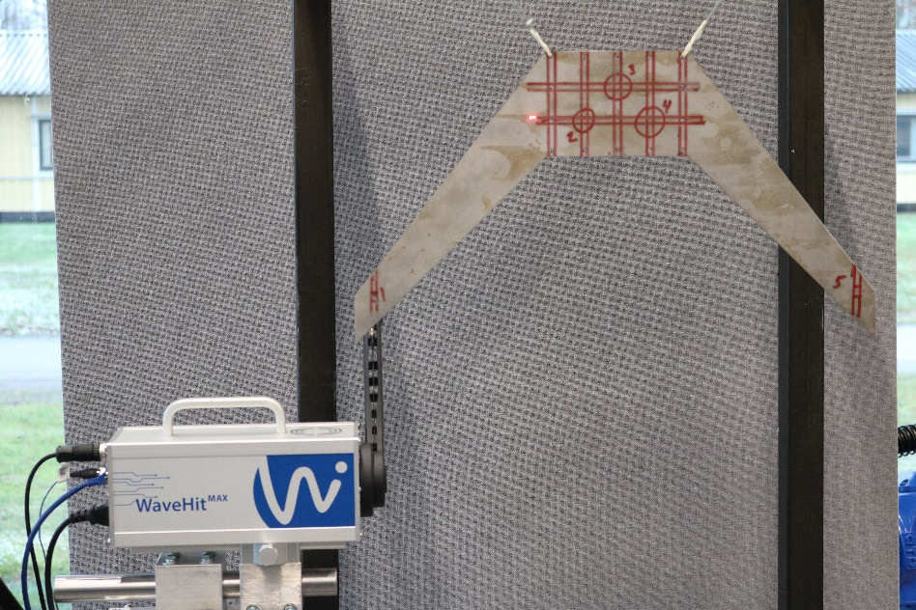
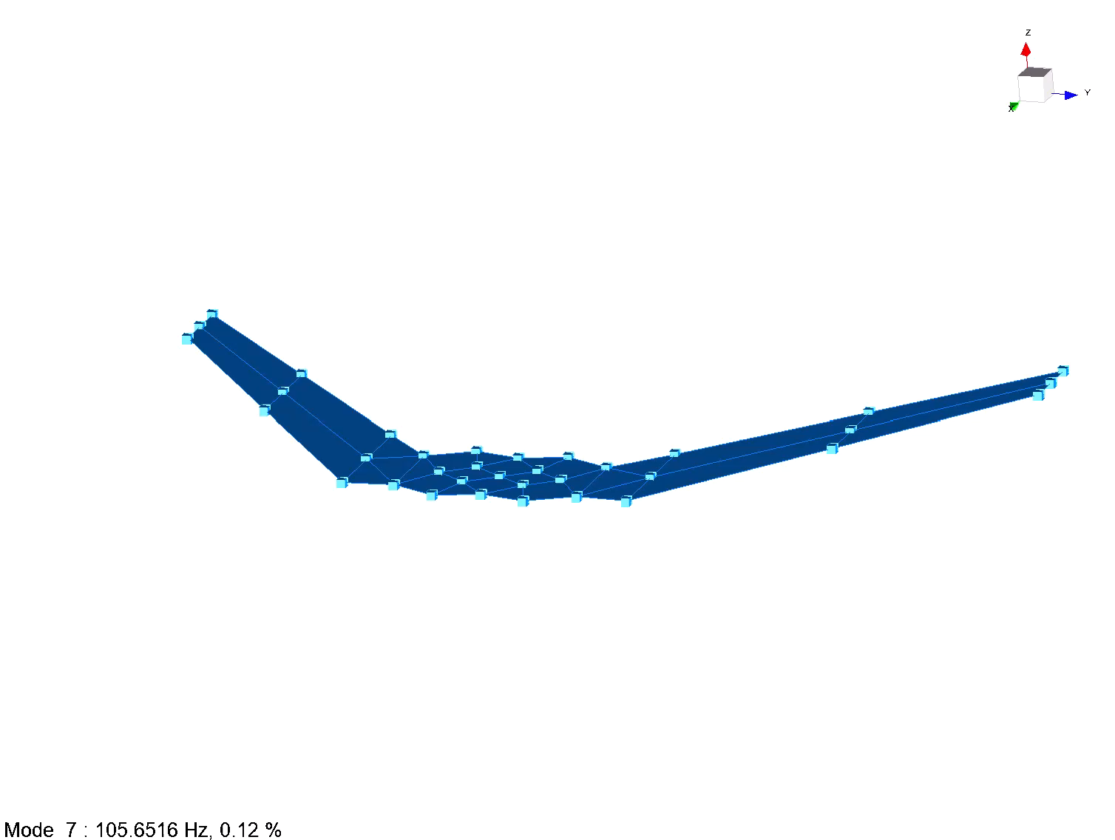
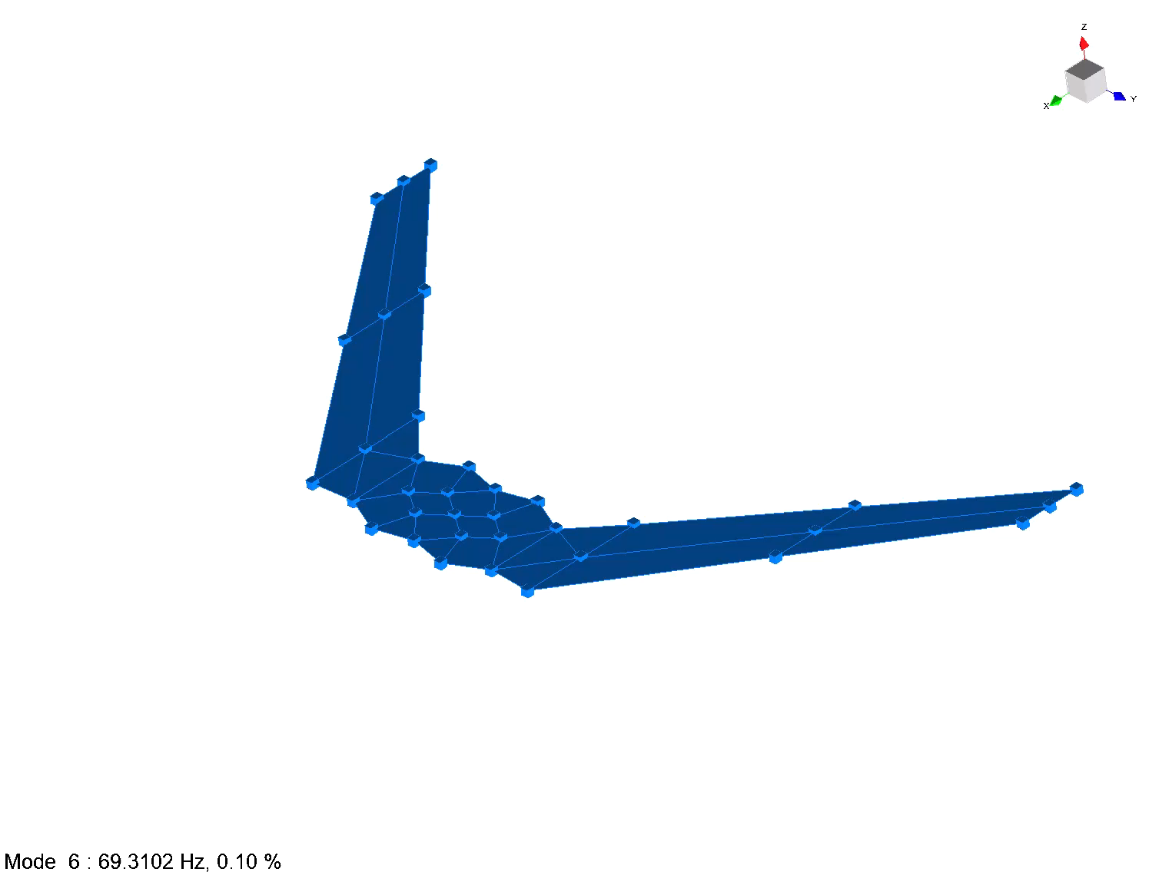
Swept Wing Model Generation
Swept wing component testing was completed at Linnæus university in order to update a finite element model which would be sent to partners at Sandia
10 swept wings are available for Dynamic Substructuring Participants with ongoing measurements to understand their variability!
A finite element model was updated to best match Swept Wing test data and provided to SNL to make initial substructuring predictions
Swept Wing No. | Mass [g] | t [mm] | f1 [Hz] | f2 [Hz] | f3 [Hz]
1 (@ Sandia) | 1169.1 | 3.0 | 69.3 | 105.7 | 182.6
2 | 1164.0 | 3.0 | 69.1 | 105.2 | 181.9
3 | 1165.0 | 3.0 | 69.1 | 105.4 | 181.9
4 | 1169.1 | 3.1 | 69.2 | 105.6 | 182.6
5 | 1164.2 | 3.0 | 69.1 | 105.3 | 181.9
6 | 1164.4 | 3.0 | NA | NA | NA
7 | 1169.9 | 3.0 | NA | NA | NA
8 | 1166.3 | 3.0 | NA | NA | NA
9 | 1169.6 | 3.0 | NA | NA | NA
10 | 1169.4 | 3.1 | NA | NA | NA

Slide 24

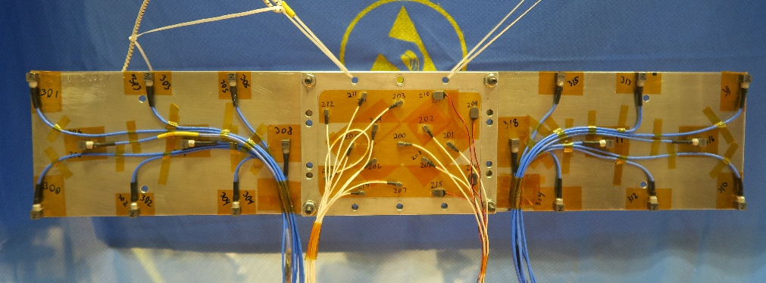
Frame, Plate, and Thin-Wing Experiments
Aluminum frame, plate, and thin-wing component assemblies were tested at Sandia.
Linear free responses were measured with accelerometers and curve fit with ATA Opoly.
Significant modes out to 1600 Hz were measured and fit to provide a rich modal basis for substructuring.
Data also used in companion project exploring incorporating nonlinear behavior into substructuring predictions that that will be presented later.

Slide 25
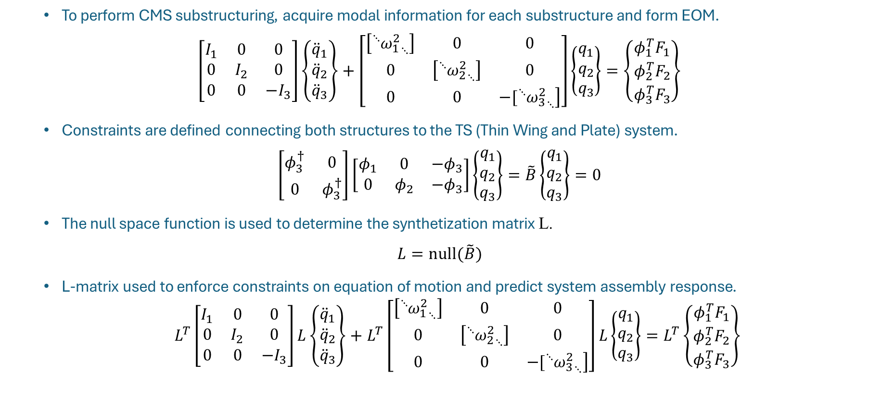
Substructuring Theory
To perform CMS substructuring, acquire modal information for each substructure and form EOM.
$$\left[\begin{matrix}I_{1} & 0 & 0 \\ 0 & I_{2} & 0 \\ 0 & 0 & {−I}_{3}\end{matrix}\right]\left\{\begin{matrix}{\ddot{q}}_{1} \\ {\ddot{q}}_{2} \\ {\ddot{q}}_{3}\end{matrix}\right\}+\left[\begin{matrix}\left[{{}_{ }^{⋱}{ω_{1}^{2}}}_{⋱}\right] & 0 & 0 \\ 0 & \left[{{}_{ }^{⋱}{ω_{2}^{2}}}_{⋱}\right] & 0 \\ 0 & 0 & \left.−[{{}_{ }^{⋱}{ω_{3}^{2}}}_{⋱}\right]\end{matrix}\right]\left\{\begin{matrix}q_{1} \\ q_{2} \\ q_{3}\end{matrix}\right\}=\left\{\begin{matrix}φ_{1}^{T}F_{1} \\ φ_{2}^{T}F_{2} \\ φ_{3}^{T}F_{3}\end{matrix}\right\}$$
Constraints are defined connecting both structures to the TS (Thin Wing and Plate) system.
$$\left[\begin{matrix}φ_{3}^{†} & 0 \\ 0 & φ_{3}^{†}\end{matrix}\right]\left[\begin{matrix}φ_{1} & 0 & {−φ}_{3} \\ 0 & φ_{2} & {−φ}_{3}\end{matrix}\right]\left\{\begin{matrix}q_{1} \\ q_{2} \\ q_{3}\end{matrix}\right\}=\tilde{B}\left\{\begin{matrix}q_{1} \\ q_{2} \\ q_{3}\end{matrix}\right\}=0$$
The null space function is used to determine the synthetization matrix L.
$$L=null(\tilde{B})$$
L-matrix used to enforce constraints on equation of motion and predict system assembly response.
$L^{T}\left[\begin{matrix}I_{1} & 0 & 0 \\ 0 & I_{2} & 0 \\ 0 & 0 & {−I}_{3}\end{matrix}\right]L\left\{\begin{matrix}{\ddot{q}}_{1} \\ {\ddot{q}}_{2} \\ {\ddot{q}}_{3}\end{matrix}\right\}+L^{T}\left[\begin{matrix}\left[{{}_{ }^{⋱}{ω_{1}^{2}}}_{⋱}\right] & 0 & 0 \\ 0 & \left[{{}_{ }^{⋱}{ω_{2}^{2}}}_{⋱}\right] & 0 \\ 0 & 0 & \left.−[{{}_{ }^{⋱}{ω_{3}^{2}}}_{⋱}\right]\end{matrix}\right]L\left\{\begin{matrix}q_{1} \\ q_{2} \\ q_{3}\end{matrix}\right\}=L^{T}\left\{\begin{matrix}φ_{1}^{T}F_{1} \\ φ_{2}^{T}F_{2} \\ φ_{3}^{T}F_{3}\end{matrix}\right\}$

Slide 26
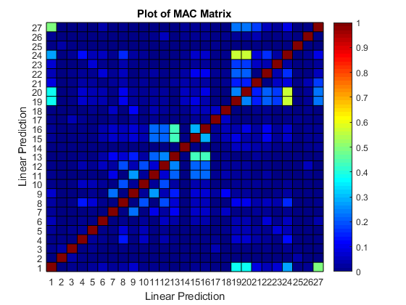

Initial Substructuring Results
Prediction
fn [Hz] | zt
0.00 | 0.04%
0.03 | 0.03%
0.05 | 0.04%
0.06 | 0.08%
0.06 | 0.13%
0.08 | 0.26%
0.09 | 0.86%
53.26 | 1.03%
67.63 | 4.72%
202.15 | 0.17%
235.34 | -6.02%
288.27 | -6.02%
363.56 | 0.75%
402.58 | 0.77%
416.43 | 0.57%
416.43 | 0.57%
439.75 | 0.65%
448.39 | 1.36%
We set our initial goal to predict modes blindly out to 500 Hz
Using previous heuristics we retained modes of each subassembly out to 1,000 Hz to ensure we included the proper modes
cond($\tilde{B}$) = 41.31
Frame, Plate, Wing: 23 modes
Plate and Wing: 16 modes
Plate and Swept Wing: 20 modes
Excess Rigid Modes
Spurious Modes
Imaginary Eigen Frequencies!
Negative Damping?

Slide 27

Tricks and Checks 1: Rigid Check
Prediction
fn [Hz] | zt
0.026 | 0.04%
0.053 | 0.03%
0.054 | 0.02%
0.057 | 0.04%
0.075 | 0.04%
0.079 | 0.04%
Attempt substructuring with just rigid modes to check if connections are incorrect and shape/geometry documentation are in line
cond($\tilde{B}$) = 6.2
Frame, Plate, Wing: 6 modes
Plate and Wing: 6 modes
Plate and Swept Wing: 6 modes
Rigid modes substructure as expected!

Slide 28
Tricks and Checks 2: Modal Space Check
Check to ensure modes when partitioned down to the connection degrees of freedom span the space for the structures included!
Here – we can see we don’t have the right information in the TS (Plate and Wing Subassembly) to describe the interface motion of the baseline assembly for mode 23!
Let’s truncate our baseline assembly down to 20 modes (and the subpieces down to 14) so we are only including modes we need to span the space

Slide 29
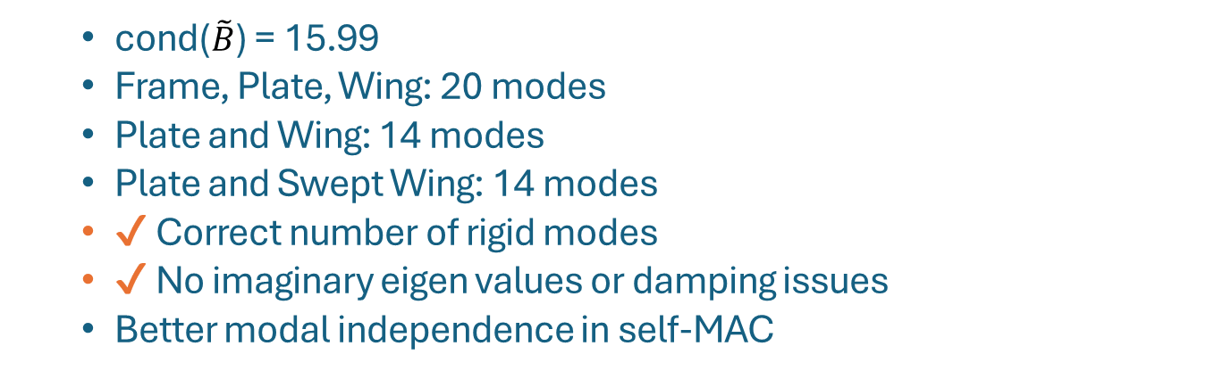
Updated Substructuring Results
Initial Prediction | Updated Prediction
fn [Hz] | fn [Hz]
0.00 | 0.03
0.03 | 0.05
0.05 | 0.05
0.06 | 0.06
0.06 | 0.07
0.08 | 0.08
0.09 | 42.69
53.26 | 65.88
67.63 | 173.93
202.15 | 223.33
235.34 | 260.63
288.27 | 325.94
363.56 | 371.69
402.58 | 442.23
416.43 | 518.81
416.43 | 603.64
439.75 | 631.52
448.39 | 814.78
cond($\tilde{B}$) = 15.99
Frame, Plate, Wing: 20 modes
Plate and Wing: 14 modes
Plate and Swept Wing: 14 modes
✔ Correct number of rigid modes
✔ No imaginary eigen values or damping issues
Better modal independence in self-MAC

Slide 30
“Truth” Comparison
Blind Prediction results concluded with fairly accurate estimate!
Prediction Modal Index | Predicted | Truth | Error | MAC
1 | 42.78 | 49.33 | -13.3% | 0.98
2 | 65.99 | 66.25 | -0.4% | 0.99
3 | 174.1 | 181.4 | -4.0% | 0.95
4 | 223.9 | 226.8 | -1.3% | 0.96
5 | 260.7 | 259.5 | 0.5% | 0.95
6 | 326.4 | 293.1 | 11.4% | 0.89
7 | 371.7 | 389.1 | -4.5% | 0.76
8 | 442.7 | 425.5 | 4.0% | 0.55
9 | 520.2 | 487.6 | 6.7% | 0.71
10 | 603.9 | 414.1 | 45.8% | 0.58
11 | 631.7 | 619.1 | 2.0% | 0.52

Slide 31
Linear Results Shape Plots
Shapes of some of the significant modes
Truth Elastic Modes 1-4
Prediction Elastic Modes 1-4

Slide 32
Results from Tuning Modal Basis
Prediction Modal Index | Predicted | Truth | Error | MAC
1 | 50.93 | 49.33 | 3.2% | 0.99
2 | 67.62 | 66.25 | 2.1% | 0.99
3 | 191.9 | 181.4 | 5.8% | 0.98
4 | 231.8 | 226.8 | 2.2% | 0.97
5 | 269.8 | 259.5 | 4.0% | 0.97
6 | 348.0 | 293.1 | 18.7% | 0.85
7 | 389.6 | 389.1 | 0.1% | 0.90
8 | 420.2 | 414.1 | 1.5% | 0.89
9 | 433.2 | 425.5 | 1.8% | 0.94
10 | 503.0 | 487.6 | 3.2% | 0.79
11 | 548.2 | 509.1 | 7.7% | 0.87
12 | 639.5 | 619.1 | 3.3% | 0.94
13 | 700.0 | 704.5 | -0.6% | 0.44
14 | 738.6 | 669.7 | 10.3% | 0.73
15 | 820.8 | 856.2 | -4.1% | 0.96
16 | 930.1 | 911.0 | 2.1% | 0.39
Informed Prediction yields better results
Frame, Plate, Wing: 62 modes
Plate and Wing: 22 modes
Plate and Swept Wing: 26 modes
Notes:
Results if we use the truth values to tune in the modal basis selctions

Slide 33
Let’s take a break

